Slide 1

Inleiding Data Wrangling met Python & Jupyter Notebooks handson workshop
Lucas Jellema
Conclusion Machine Learning Gilde
21 februari 2019

Slide 2
Agenda
Introductie van de Data Science Data Flow
Introductie van Python, Jupyter Notebook en Panda
Aan de slag met Jupyter Notebook
Diner
Introductie van de casus en de beschikbare data
Hands-on workshop:
Verzamel de raw data (JSON) in een data lake (het file systeem)
Wrangle de data (fase I) – reshape, discard, deduplicate, derive
Wrangle de data (fase II) – join/merge, verrijk
Business Intelligence – visualisatie, rapportage
Machine Learning – train en test model vanuit Notebook (Decision tree, Classification)

Slide 3

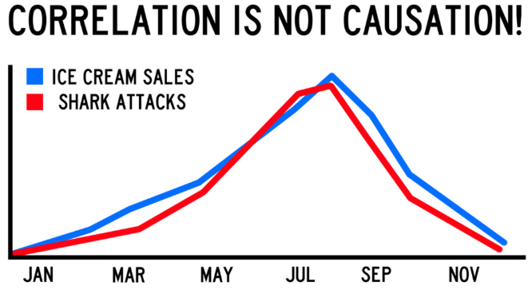
Waarde van data
Inzicht in huidige stand van zaken
Inzicht in trends
Inzicht in afwijkingen en uitzonderingen
Inzicht in patronen, correlaties, oorzaken

Slide 4
Waarde van data
Inzicht in huidige stand van zaken
Inzicht in trends
Inzicht in afwijkingen en uitzonderingen
Inzicht in patronen, correlaties, oorzaken
Geconsolideerd uit meerdere bronnen
Geschoond, gefilterd, gestandaardiseerd, verrijkt
Geïnterpreteerd en geaggregeerd naar betekenisvol niveau
Gerepresenteerd in interpreteerbare vorm
Gemeld en opvraagbaar op juiste moment en via optimale kanaal
Leidend tot begrip, beslissingen, acties, voorspelbaarheid, suggesties
En tot rijkere user experience – leukere, efficiëntere, effectievere user interfaces

Slide 5
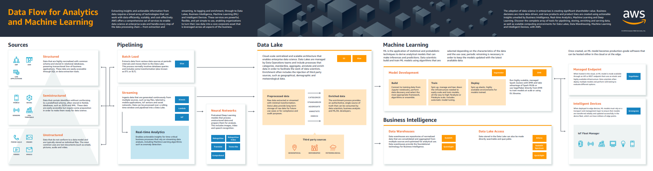
Data Flow – from raw data to business insight & action
Machine Learning
Deploy & Leverage
Data Warehouse
Machine Learning Model
Raw/ Operational Data Sources
Data Pipeline
Data Wrangling
“Data Mart” single purpose data set
Data Lake
Business Intelligence
Dashboard, Notification & Alert Report, Visualization, Gamification, Data Explorer
3rd party data sources
Business insight: what, when, who and why
algorithms

Slide 6
Data Flow – from raw data to business insight & action
Eenmalig
Periodiek, in batch
Continue, event gebaseerd
Machine Learning
Deploy & Leverage
Data Warehouse
Machine Learning Model
Raw/ Operational Data Sources
Data Pipeline
Data Wrangling
“Data Mart” single purpose data set
Data Lake
Business Intelligence
Dashboard, Notification & Alert Report, Visualization, Gamification, Data Explorer
3rd party data sources
Business insight: what, when, who and why
algorithms
Master Data Management, Meta-Data Management, Data Governance
Data Access, Authorization, Privacy
Notes:
Iteratief – keer terug naar voorgaande stap om meer data, andere wrangling

Slide 7
Data Flow – from raw data to business insight & action
ETL/ELT, Change Data Capture, Event Bus/Message Queue, file/ftp handlers, adapters, ESB, Web Scraping, Streaming (event) Analytics …
Relationele Database
NoSQL Database (Document Store, Key/Value Store, GraphDB, Time Series, ..)
Hadoop
Event Store
Object Store, Block Store
Data Warehouse
Raw/ Operational Data Sources
Data Pipeline
Data Lake
Standaard Business Applicaties & SaaS (SAP, Oracle EBS, Siebel, SalesForce, AFAS, Dynamics)
Maatwerk Applicaties
Fast Sources: IoT, Web Clicks, Social Media, Events
Unstructured: image/video, log-files, text/CMS, email
…

Slide 8
Data Flow – from raw data to business insight & action
Data Warehouse
Raw/ Operational Data Sources
Data Pipeline
Data Wrangling
“Data Mart” single purpose data set
Data Lake
3rd party data sources
algorithms

Slide 9
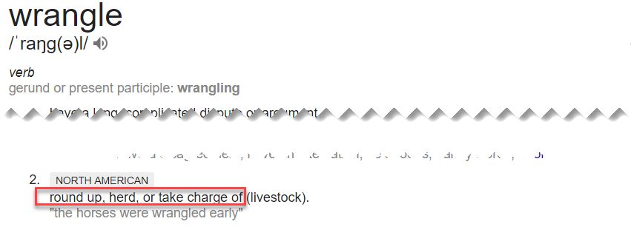
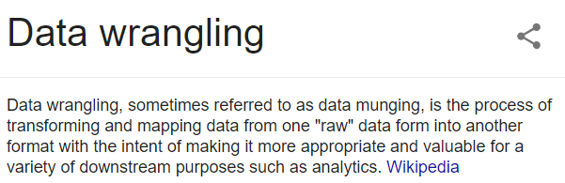
Data Wrangling

Slide 10
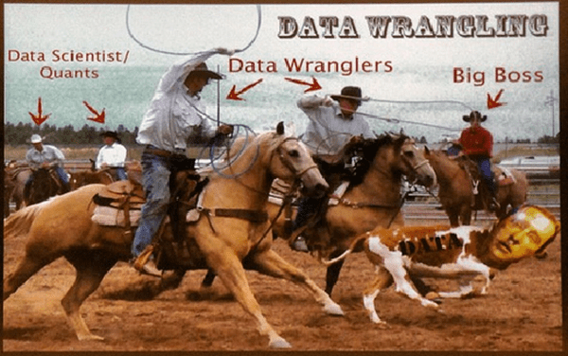

Slide 11
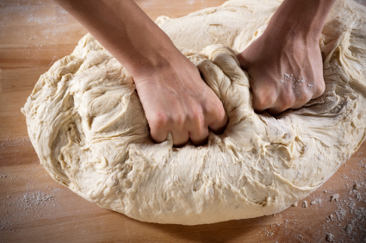
Data kneden
Ruwe ingrediënten combineren en manipuleren tot de juiste vorm en samenstelling is bereikt
AMIS Consultant
Data
Data

Slide 12
Data Flow – from raw data to business insight & action
Verken, visualiseer, beschrijf
Extract, parse,interpret
Cleanse & Validate
Filter, Deduplicate, Denormalize
Unify (units, language, spelling, coding)
Convert & Transform
Anonimiseer, Obfuscate/Redact
Enrich
Join, Aggregate
Feature engineering
Relationele Database
NoSQL Database
Hadoop
Object Store
Data Warehouse
Raw/ Operational Data Sources
Data Pipeline
Data Wrangling
“Data Mart” single purpose data set
Data Lake
OCR
Speech to Text
Sentiment Analysis
Gist / Topics extraction
Image recognition
Translation
Spelling correction
Anomaly detection
Classification
Principal Component Analysis
3rd party data sources
Open Data APIs (overheden, NGOs, bedrijven)
Social Media
Kaggle, data.world
DaaS-aanbieders
algorithms
Notes:
https://help.data.world/hc/en-us/articles/360006491854-What-does-data-world-do- - video?

Slide 13
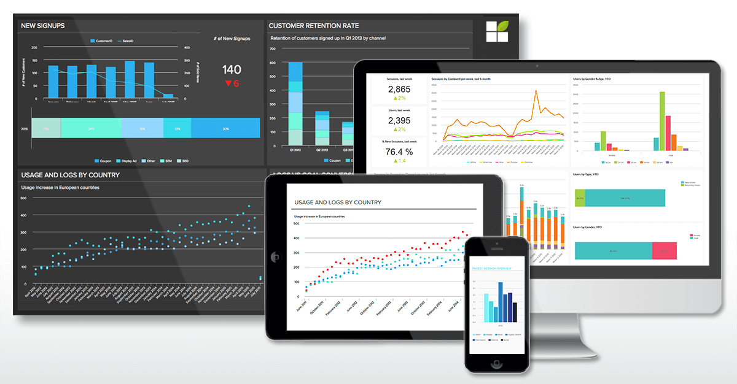
Data Flow – from raw data to business insight & action
Ontwerp Visualisatie, Rapport, Dashboard, Notificatie, Animatie, self-service data verkenning voorziening
Multi-channel, pull/push, distributie, conditie
Implementeer | Test | Roll Out | Operate
Enforce Data Authorization
Data Warehouse
Raw/ Operational Data Sources
Data Pipeline
Data Wrangling
“Data Mart” single purpose data set
Data Lake
Business Intelligence
Dashboard, Notification & Alert Report, Visualization, Gamification, Data Explorer
3rd party data sources
Business insight: what, when, who and why
algorithms

Slide 14
Data Flow – from raw data to business insight & action
Machine Learning
Deploy & Leverage
Data Warehouse
Machine Learning Model
Raw/ Operational Data Sources
Data Pipeline
Data Wrangling
“Data Mart” single purpose data set
Data Lake
Business Intelligence
Dashboard, Notification & Alert Report, Visualization, Gamification, Data Explorer
3rd party data sources
Business insight: what, when, who and why
algorithms

Slide 15
Niveaus van AI/Machine Learning
Generic, Out of the box, ready to use (AI Services)
OCR, Image & Video Recognition, Sentiment Analysis, Speech to Text, Text Gist/Summary, Text to Speech
Guided training met je eigen data van een voorgedefinieerd model voor specifieke toepassing
IoT Predictive Analytics, Forecast, Recommendation, ChatBot, Cloud Talent
Do it (largely) yourself ML
Train your own model on your own data set using frameworks, libraries and raw technologies
En: Google AutoML & AWS SageMaker

Slide 16
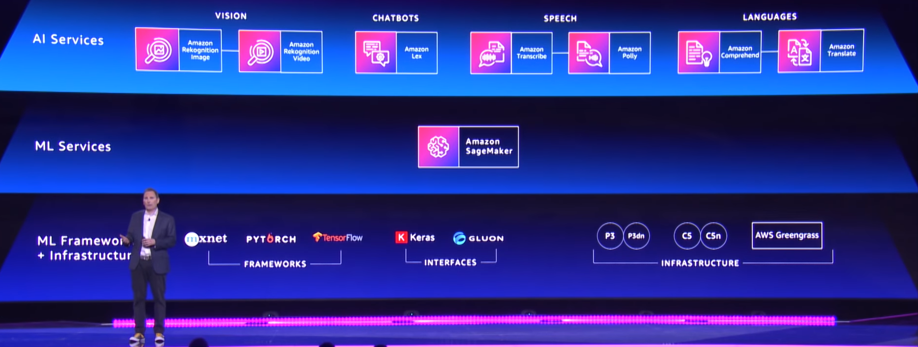

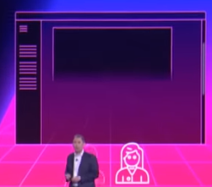
AWS AI & Machine Learning (powered) services
Forecast
Personalize

Slide 17
Data Flow – from raw data to business insight & action
Selecteer algoritme
Configureer model
Train model met training data
Test Model
… itereer ….
Accepteer Model
Machine Learning
Deploy & Leverage
Data Warehouse
Machine Learning Model
Raw/ Operational Data Sources
Data Pipeline
Data Wrangling
“Data Mart” single purpose data set
Data Lake
Business Intelligence
Dashboard, Notification & Alert Report, Visualization, Gamification, Data Explorer
3rd party data sources
Business insight: what, when, who and why
algorithms

Slide 18


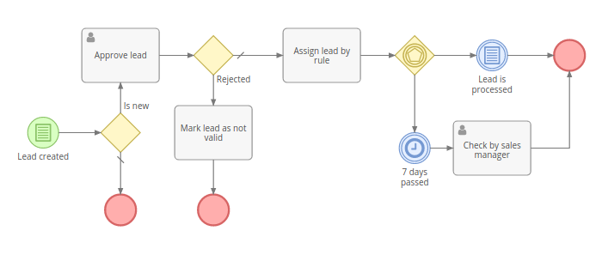
Leveraging Machine Learning models
Application
API
Machine Learning
Deploy & Leverage
ML Model
Machine Learning Model
“Data Mart” single purpose data set
Data Wrangling
algorithms

Slide 19
[voorbeelden van] Technologie in Data Flow
Python, R, Apache Spark, SQL & PL/SQL
Jupyter Notebooks, Apache Zeppelin
NumPy, SciPy, SciKit-learn, Pandas, Bokeh, Plotly, Matplotlib, NLTK
Keras, TensorFlow, PyTorch, MXNet, Caffe, Theano
Oracle Analytics Cloud, Data Science Platform
AutoKeras
AWS SageMaker, Google AI Platform, Google AutoML, Azure Machine Learning Studio
Azure Cognitive Services, AWS AI
Oracle Autonomous Datawarehouse Cloud, AWS RedShift, Google BigData, Azure SQL Data Warehouse, Azure Data Lake Store, Oracle Database
Azure Cosmos DB, Elastic Stack, MongoDB,InfluxDB Cassandra, AWS DynamoDB, Excel
Hadoop, Kafka, Oracle BigData Cloud
AWS S3, Oracle Storage, OneDrive, Google Storage
Machine Learning
Deploy & Leverage
Data Warehouse
Machine Learning Model
Raw/ Operational Data Sources
Data Pipeline
Data Wrangling
“Data Mart” single purpose data set
Data Lake
Business Intelligence
Dashboard, Notification & Alert Report, Visualization, Gamification, Data Explorer
3rd party data sources
Business insight: what, when, who and why
Jupyter Notebooks, Python, Apache Spark, Java, R, Apache Zeppelin
SQL & PL/SQL, SQL Developer, SPARQL
Oracle Analytics Cloud
Google Cloud DataPrep, Azure Wrangler (Trifacta Wrangler)
Google BigQuery
Excel, csvkit, Pentaho
SQL, Java, Python, Node JS
SQL Developer, Apache Spark, Drill, Flink
Oracle Data Integration Platform Cloud, Oracle Integration Cloud & Cloud Adapters
Kafka, Connectors, KSQL & Streams Debezium
Azure EventHubs
AWS Lambda, SQS, SNS, Glue, Kinesis, Step Functions
algorithms
d3.js, React D3, SVG
Oracle Analytics Cloud
Excel, APEX, SQL Developer
Pentaho, OpenStreetMap
Azure PowerBI, AWS QuickSight
Tableau, Qlik, Looker,
SAP Analytics (Business Objects), IBM Cognos, SAS, Tibco JasperSoft
Kibana, Grafana, Jupyter Notebooks, Python

Slide 20
[voorbeelden van] Technologie in Data Flow
Python, R, Apache Spark, SQL & PL/SQLJupyter Notebooks, Apache Zeppelin
NumPy, SciPy, SciKit-learn, Pandas, Bokeh, Plotly, Matplotlib, NLTK, Keras, TensorFlow, PyTorch, MXNet, Caffe, Theano, Oracle Analytics Cloud, Data Science Platform
AutoKeras, AWS SageMaker, Google AI Platform, Google AutoML, Azure Machine Learning Studio, Azure Cognitive Services, AWS AI
Oracle Autonomous Datawarehouse Cloud, AWS RedShift, Google BigData, Azure SQL Data Warehouse, Azure Data Lake Store, Oracle Database
Azure Cosmos DB, Elastic Stack, MongoDB,InfluxDB Cassandra, AWS DynamoDB, Excel
Hadoop, Kafka, Oracle BigData Cloud
AWS S3, Oracle Storage, OneDrive, Google Storage
Machine Learning
Deploy & Leverage
Data Warehouse
Machine Learning Model
Raw/ Operational Data Sources
Data Pipeline
Data Wrangling
“Data Mart” single purpose data set
Data Lake
Business Intelligence
Dashboard, Notification & Alert Report, Visualization, Gamification, Data Explorer
3rd party data sources
Business insight: what, when, who and why
Jupyter Notebooks, Python, Apache Spark, Java, R, Apache Zeppelin SQL & PL/SQL, SQL Developer, SPARQL Oracle Analytics Cloud Google Cloud DataPrep, Azure Wrangler (Trifacta Wrangler)
SQL, Java, Python, Node JS
SQL Developer, Apache Spark, Drill, Flink
Oracle Data Integration Platform Cloud, Oracle Integration Cloud & Cloud Adapters
Kafka, Connectors, KSQL & Streams Debezium
Azure EventHubs
AWS Lambda, SQS, SNS, Glue, Kinesis, Step Functions
algorithms
Jupyter Notebooks, Python d3.js, React D3, SVG
Oracle Analytics Cloud
Excel, APEX, SQL Developer
Pentaho, OpenStreetMap
Azure PowerBI, AWS QuickSight
Tableau, Qlik, Looker,
SAP Analytics (Business Objects), IBM Cognos, SAS, Tibco JasperSoft
Kibana, Grafana

Slide 21
Agenda
Introductie van de Data Science Data Flow
Introductie van Python, Jupyter Notebook en Panda
Aan de slag met Jupyter Notebook
Diner
Introductie van de casus en de beschikbare data
Hands-on workshop:
Verzamel de raw data (JSON) in een data lake (het file systeem)
Wrangle de data (fase I) – reshape, discard, deduplicate, derive
Wrangle de data (fase II) – join/merge, verrijk
Business Intelligence – visualisatie, rapportage
Machine Learning – train en test model vanuit Notebook (Decision tree, Classification)

Slide 22
Introductie Python & Jupyter

Slide 23
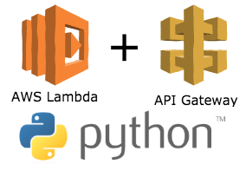
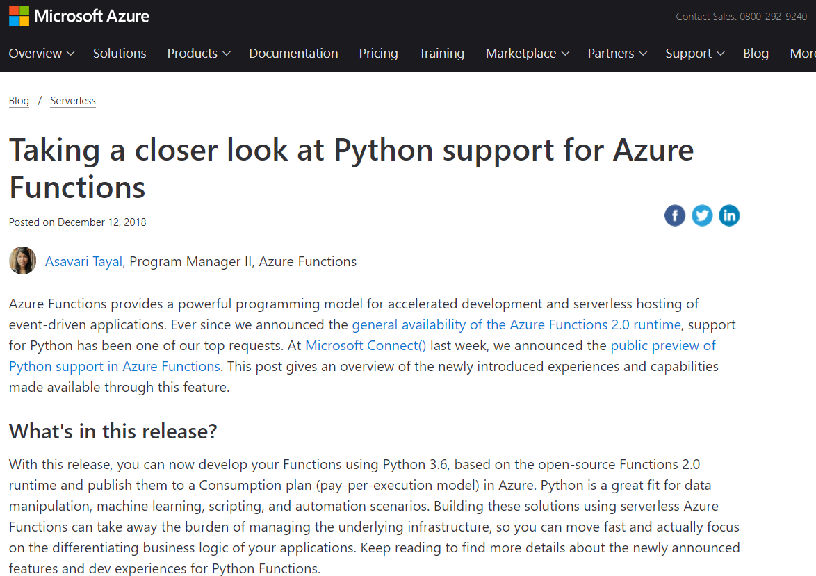
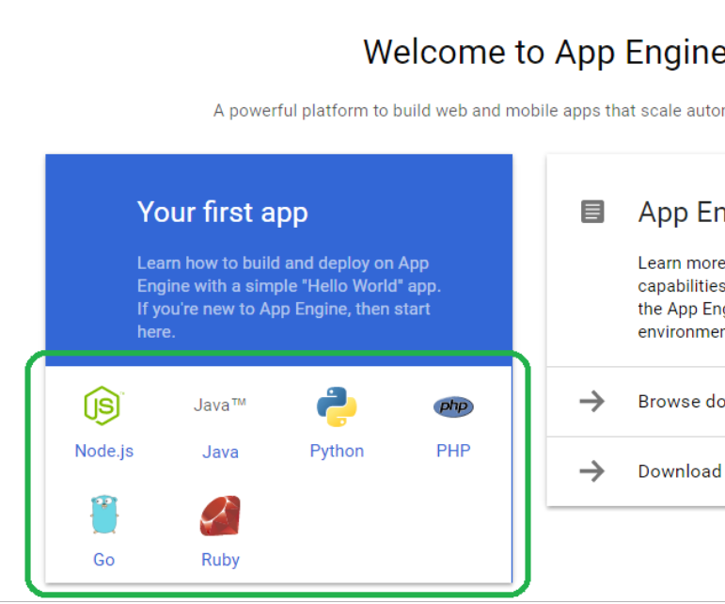
Azure Functions support Python
Notes:
https://azure.microsoft.com/en-us/blog/taking-a-closer-look-at-python-support-for-azure-functions/

Slide 24
Introductie Python & Jupyter
Onderstaande link Is een analyse van wijzigingen op Github. Misschien te gebruiken in een introductie van Jupyter en Python.
https://www.benfrederickson.com/ranking-programming-languages-by-github-users/
Jupyter is erg populair op Github vergeleken met R en Matlab en groeit snel.
Interessant ook om te zien dat waarschijnlijk door de populariteit van ML de laatste tijd Python Java voorbij is.
Notes:
Onderstaande link Is een analyse van wijzigingen op Github. Misschien te gebruiken in een introductie van Jupyter en Python.
https://www.benfrederickson.com/ranking-programming-languages-by-github-users/
Jupyter is erg populair op Github vergeleken met R en Matlab en groeit snel.
Interessant ook om te zien dat waarschijnlijk door de populariteit van ML de laatste tijd Python Java voorbij is.

Slide 25
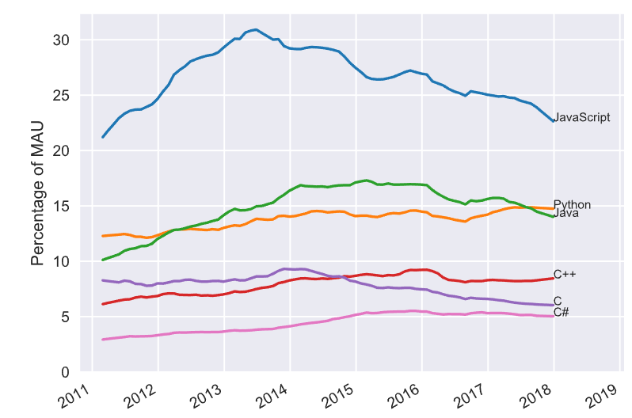
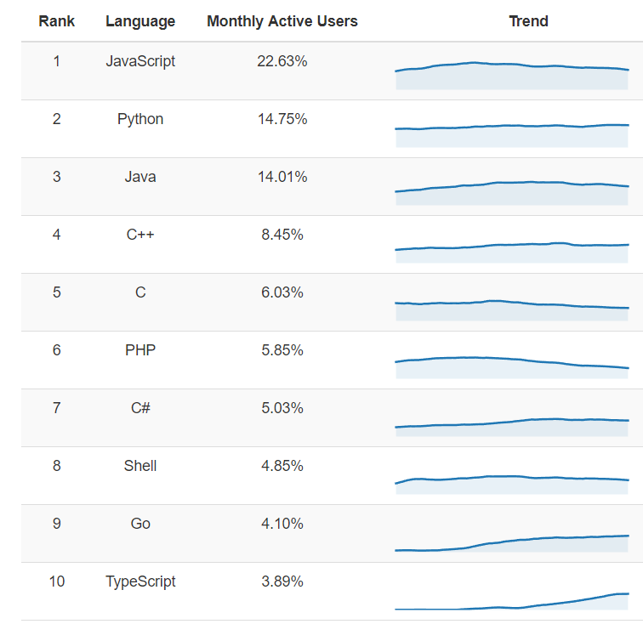
Language popularity based on GitHub activity (January 2018)

Slide 26
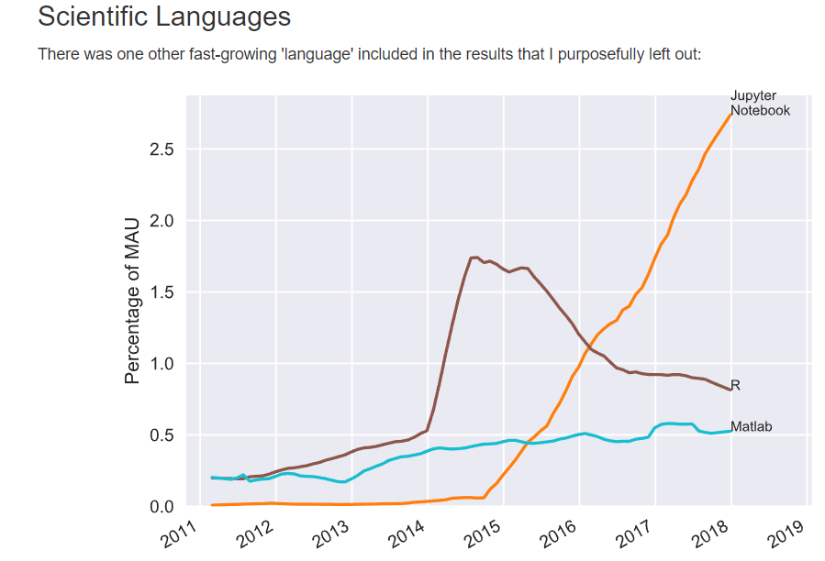

Slide 27
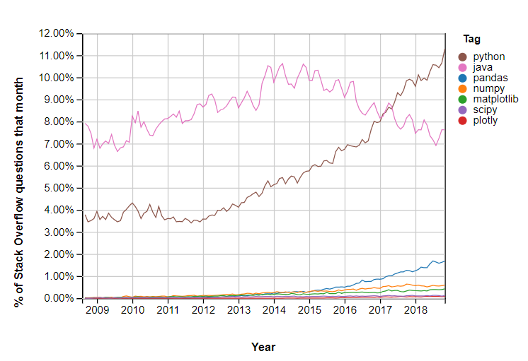
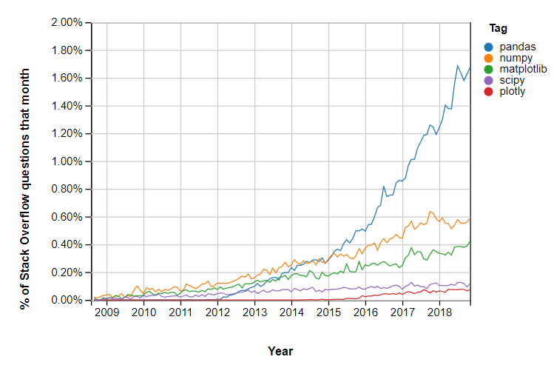
Notes:
https://insights.stackoverflow.com/trends?tags=pandas%2Cnumpy%2Cmatplotlib%2Cplotly%2Cscipy

Slide 28
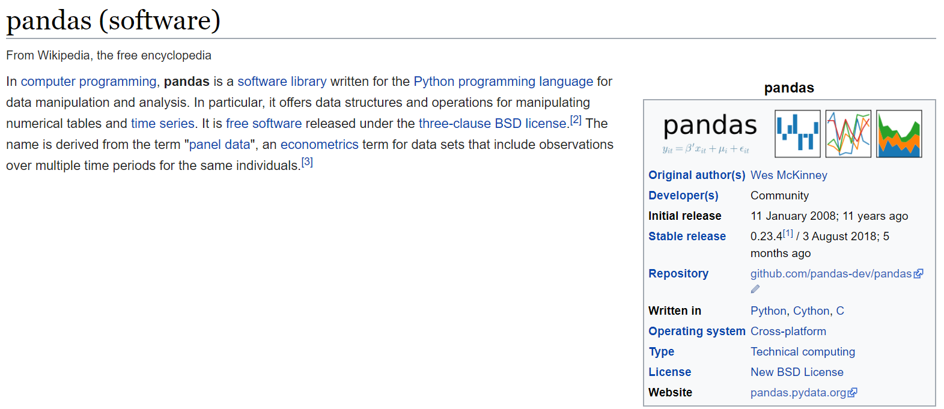
Notes:
Shift + tab (+ tab ) == help!!
Tab = autocomplete
Use ? To get docs on module (venn2? And ctrl+enter)

Slide 29
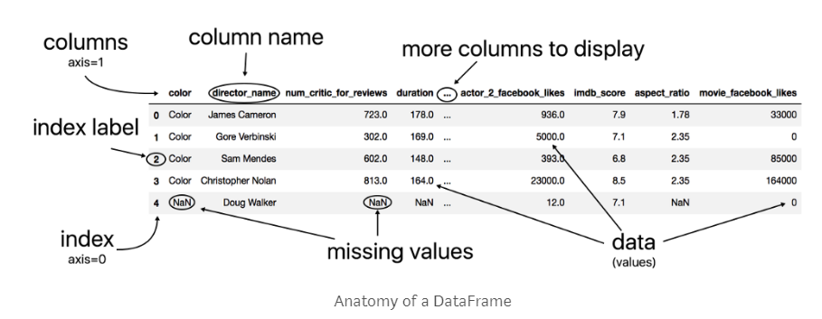
Pandas = Panel Data
Notes:
Learn pandas: https://medium.com/dunder-data/how-to-learn-pandas-108905ab4955
10 minutes to pandas: http://pandas.pydata.org/pandas-docs/stable/10min.html

Slide 30
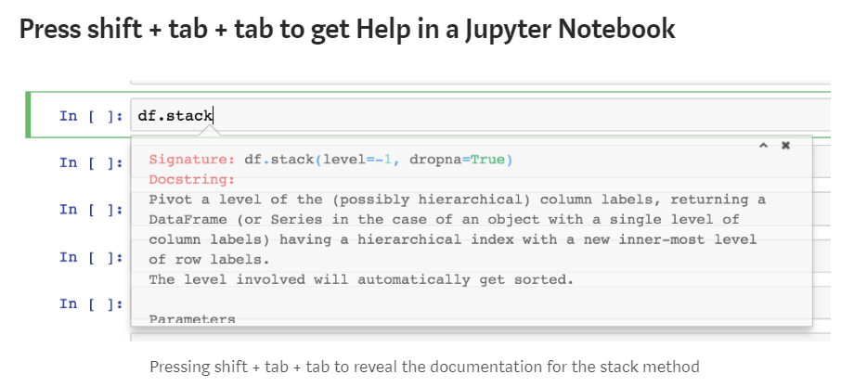
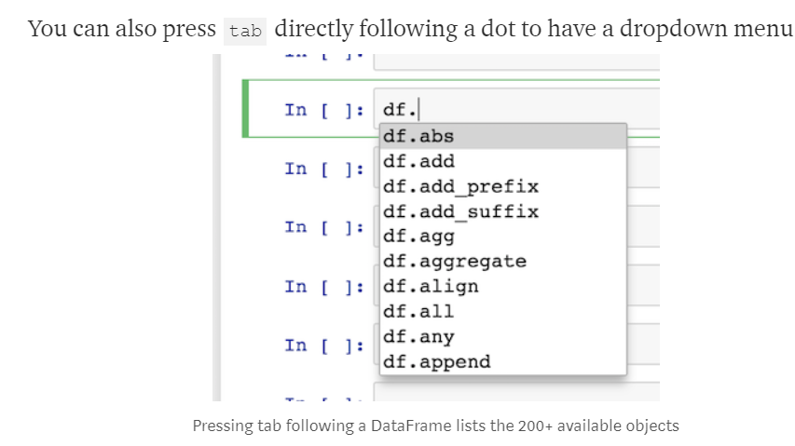

Slide 31
Agenda
Introductie van de Data Science Data Flow
Introductie van Python, Jupyter Notebook en Panda
Aan de slag met Jupyter Notebook
Diner
Introductie van de casus en de beschikbare data
Hands-on workshop:
Verzamel de raw data (JSON) in een data lake (het file systeem)
Wrangle de data (fase I) – reshape, discard, deduplicate, derive
Wrangle de data (fase II) – join/merge, verrijk
Business Intelligence – visualisatie, rapportage
Machine Learning – train en test model vanuit Notebook (Decision tree, Classification)

Slide 32
Agenda
Introductie van de Data Science Data Flow
Introductie van Python, Jupyter Notebook en Panda
Aan de slag met Jupyter Notebook
Diner
Introductie van de casus en de beschikbare data
Hands-on workshop:
Verzamel de raw data (JSON) in een data lake (het file systeem)
Wrangle de data (fase I) – reshape, discard, deduplicate, derive
Wrangle de data (fase II) – join/merge, verrijk
Business Intelligence – visualisatie, rapportage
Machine Learning – train en test model vanuit Notebook (Decision tree, Classification)

Slide 33
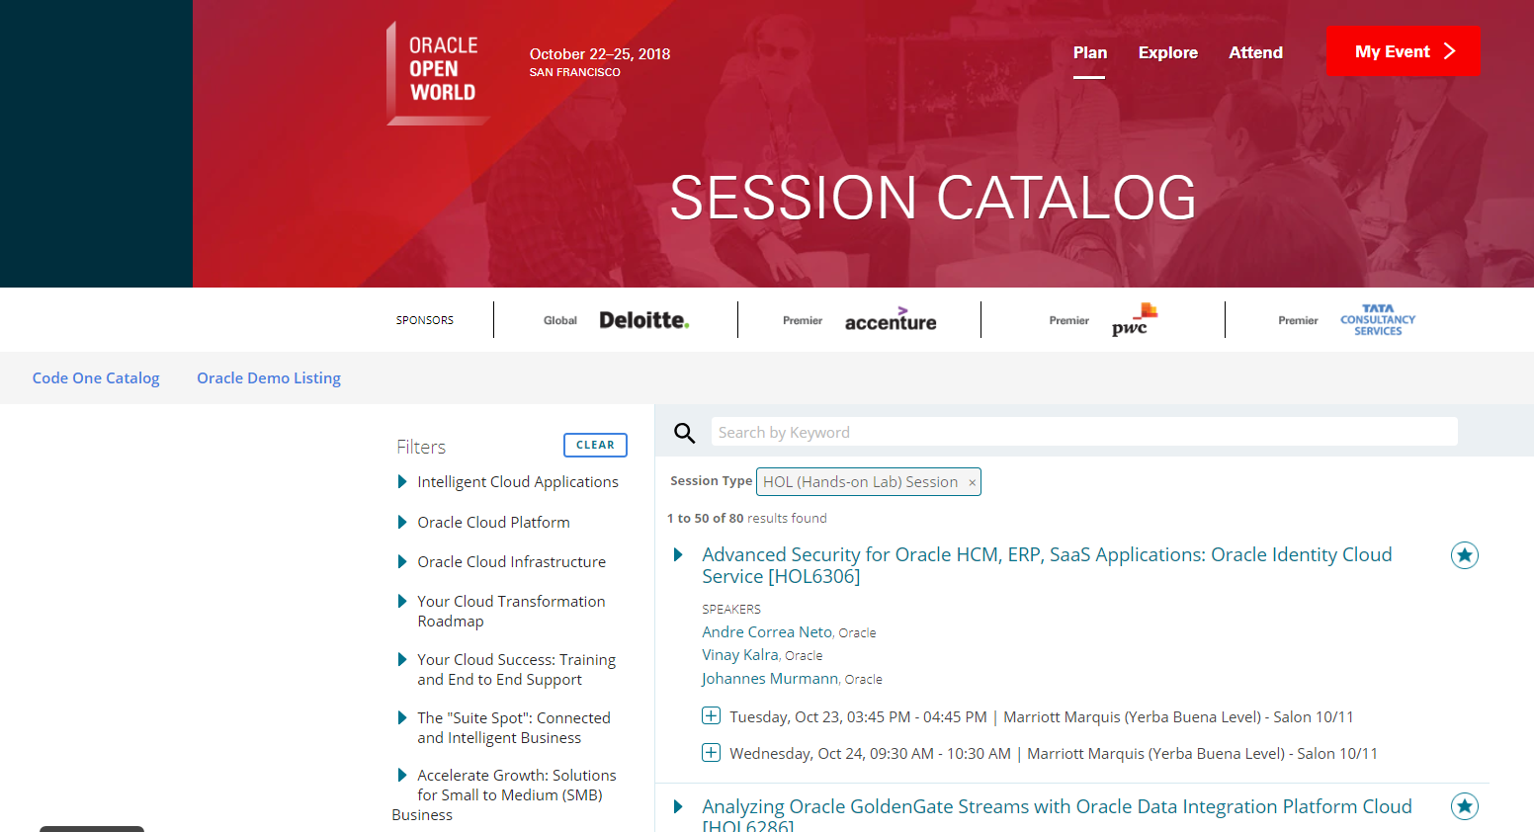
Data Analytics on Oracle OpenWorld 2018 Session Details

Slide 34
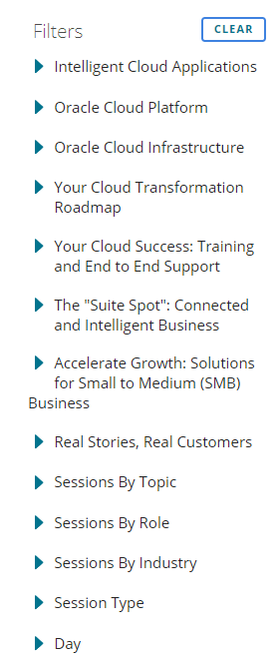
High level overview
Two events: Oracle OpenWorld 2018 and Oracle CodeOne 2018
Over 2000 sessions
Over 2500 speakers
Various dimensions:

Slide 35
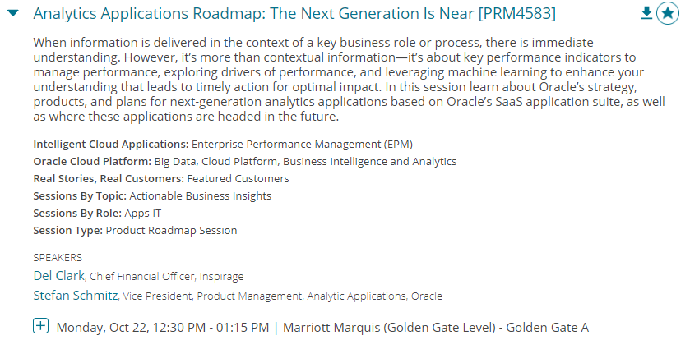
High level overview
Details per session:

Slide 36

High level overview
Details per speaker:

Slide 37


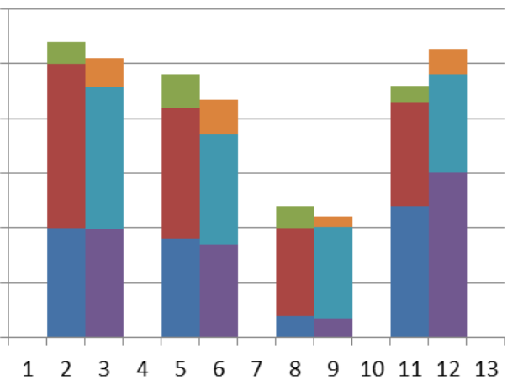

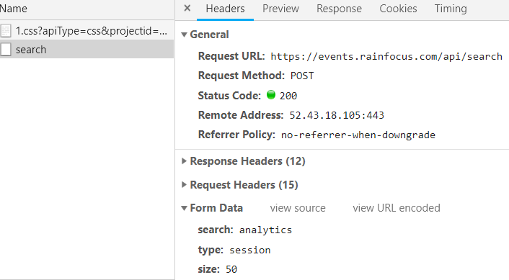

Data flow for Oracle OpenWorld 2018 Session Data
Speakers:
Read JSON file, extract speaker details, visualize and analyze speaker data
Fetch all raw session data per Event and per Session Type from API and write to 36 local JSON files
Read all JSON files, discard unneeded attributes, derive new attributes, deduplicate records and write to a single local JSON file
Jupyter Notebook & Python
Visualizations
API for session details in JSON
Jupyter Notebook & Python
Jupyter Notebook & Python
JSON file
JSON files
Jupyter Notebook & Python
Visualizations
CSV file with key Oracle Cloud Services
AMIS Kick Off 2019 - Proposities & Data Analytics
Sessions:
Read JSON file, visualize and analuyze session data

Slide 38
Data flow for Oracle OpenWorld 2018 Session Data
Fetch all raw session data per Event and per Session Type from API and write to 36 local JSON files
Read all JSON files, discard unneeded attributes, derive new attributes, deduplicate records and write to a single local JSON file
API for session details in JSON
Jupyter Notebook & Python
Jupyter Notebook & Python
JSON file
ML Model
JSON files
Jupyter Notebook & Python
Machine Learning
AMIS Kick Off 2019 - Proposities & Data Analytics
Sessions:
Decision Tree & Classification
- Predict “slides available?”
- Assign track

